Slide 1
What does the dairy industry know about inbreeding that you don’t?
John B. Cole, Chief Research & Development Officer
john.cole@uscdcb.com

Slide 2
Outline
Inbreeding is different things to different people
New inbreeding matters more than old inbreeding
We’re not alone!
Inbreeding affects different traits in different ways
Nobody can agree on what to do about it
Concluding remarks

Slide 3
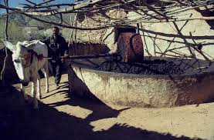
We’re all running the same race
AI aims to meet market demands
High-genetic-merit bulls are very
marketable
Lower inbreeding results in slower
rates of genetic gain
Who’s willing to go slower to
better manage inbreeding?
Source: Wikimedia Commons.

Slide 4
Inbreeding is different things to different people
Point 1

Slide 5
Inbreeding arises when related animals are mated
It’s the proportion of the genome that’s identical because it came from the same ancestor
Inbreeding arises when related animals are mated
  Increased coancestry results in reduced genetic variance
Inbreeding is inevitable in a finite population
  It can be managed, but not prevented

Slide 6
What aspects of selection favor inbreeding?
Multiple generations of intense directional selection (Robertson, 1961)
High variance of reproductive success across individuals due to the use of advanced reproductive technologies (Nicholas and Smith, 1983)
Use of BLUP-based genetic evaluations in combination with truncation selection (Verrier et al., 1993)
These result in widespread use of related individuals as parents of the next generation (e.g., Howard et al., 2017)

Slide 7
Inbreeding often has undesirable effects
Harmful loci increase in frequency and are more likely to be paired-up
  e.g., Haplotypes such as HH1
  This is thought to account for most inbreeding depression
Slow inbreeding is more effective at selecting against harmful loci
Undesirable loci travel along with desirable loci if they’re close together (“hitchhiking”)

Slide 8
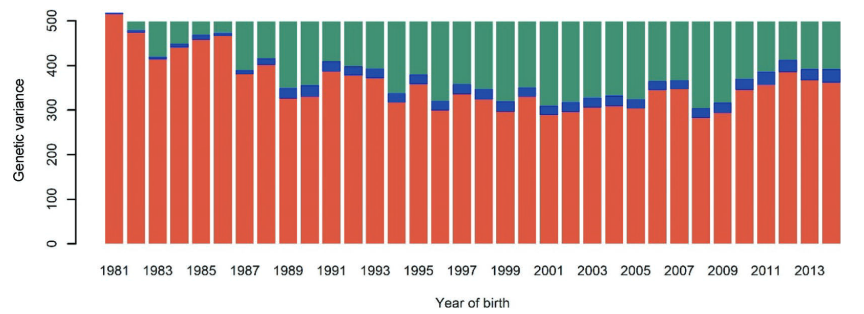
Increased coancestry reduces genetic variance
Source: Macedo et al. (2021)

Slide 9
New inbreeding matters more than old inbreeding
Point 2

Slide 10
US Holstein cattle (proven genotyped bulls)
Source: CDCB (2024)

Slide 11
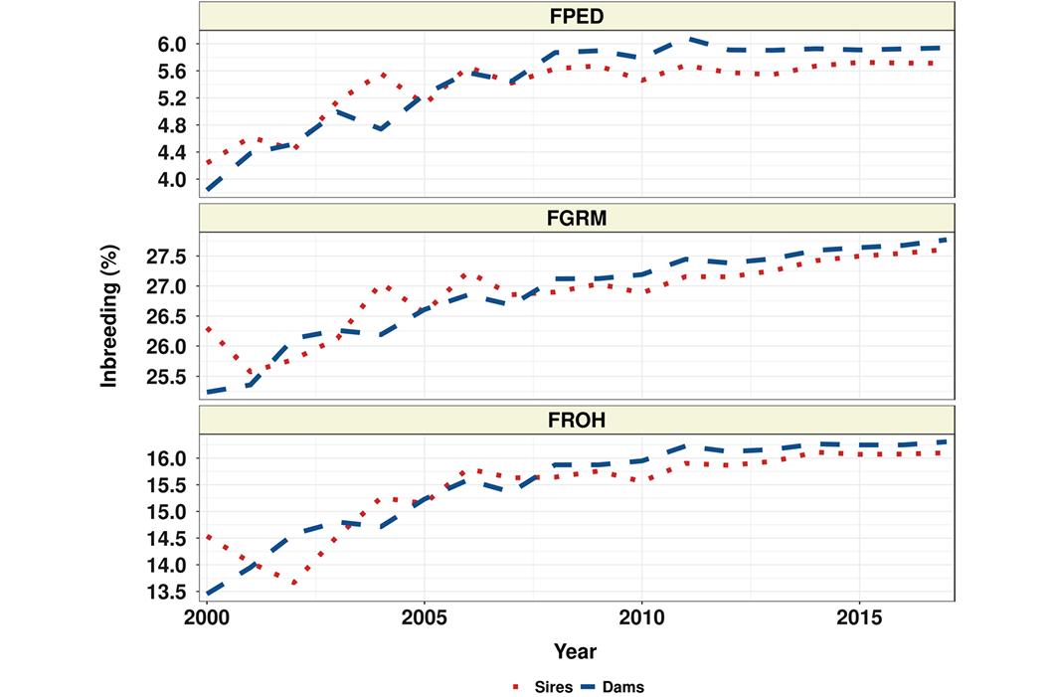
US Angus cattle
Source: Lozada-Soto et al. (2021)

Slide 12
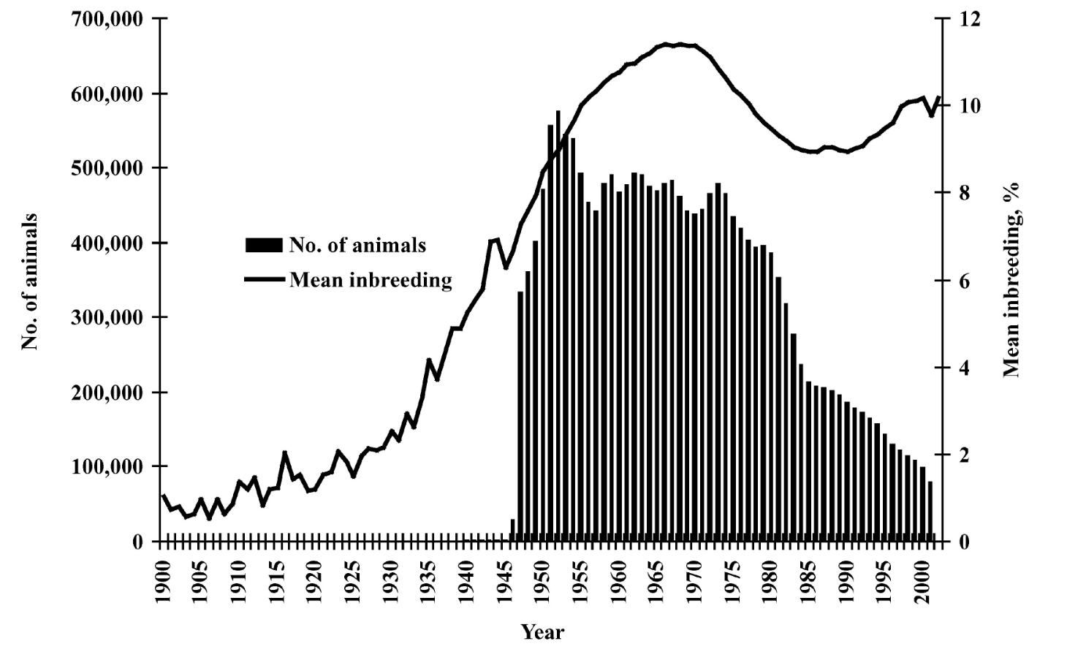
US Hereford cattle
Source: Cleveland et al. (2005)

Slide 13
We don’t know how much is too much
Selection is now on indices that include health and fitness data
This avoids past mistakes from focusing on only one or a few traits
Will we see genetic merit gradually decrease, or will we cross a threshold and see a sudden crash?
Interviewer: “How did you go bankrupt?”
Ernest Hemingway: “Two ways. Gradually, then suddenly.”
Correlation: -0.23.
Source: CDCB (2019).

Slide 14
We’re not alone!
Point 3

Slide 15
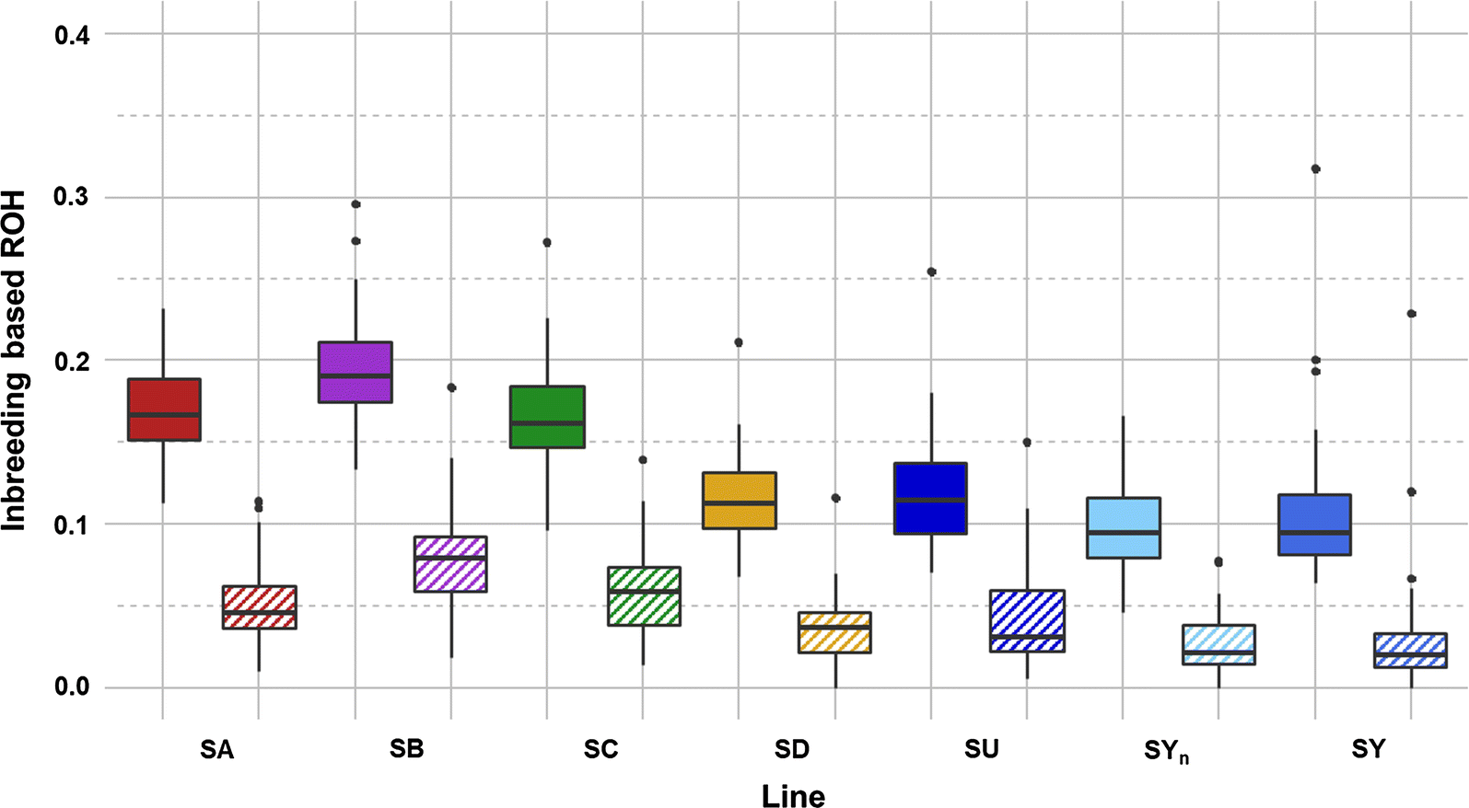
Commercial rainbow trout lines
Box plots of total inbreeding (FROH) and recent inbreeding (FROH>10) for each rainbow trout line.
Plain box: total inbreeding (FROH).
Hatched box: recent inbreeding (FROH>10).
Source: D’Ambrosio et al. (2019)

Slide 16
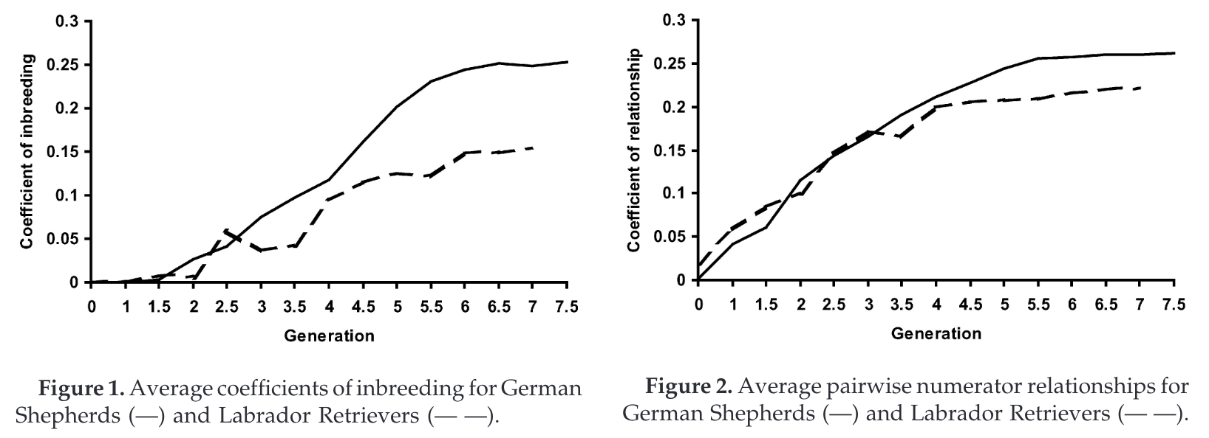
Working dogs
Source: Cole et al. (2004)

Slide 17
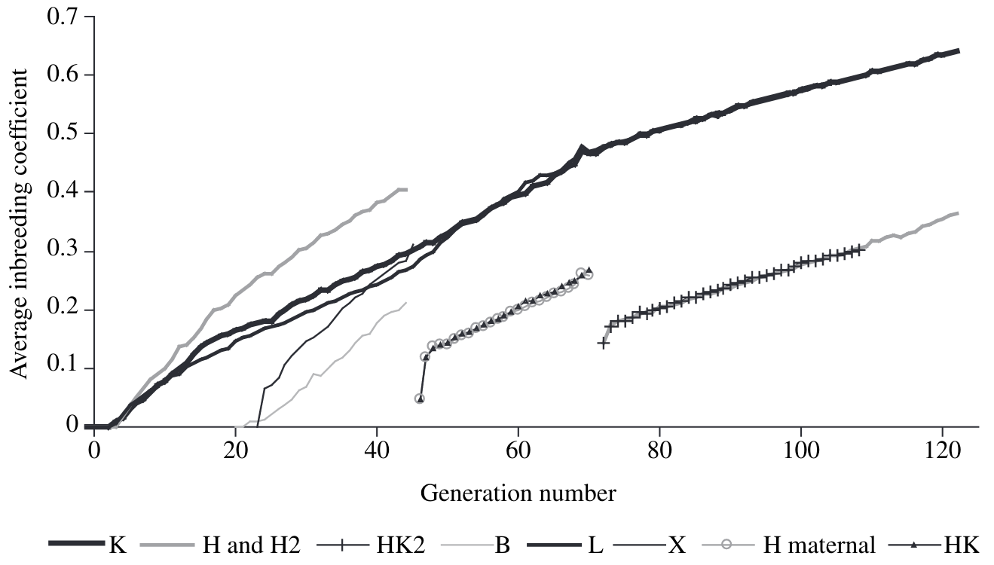
122 generations of mice
Source: Holt et al. (2005)

Slide 18
Inbreeding affects different traits in different ways
Point 4

Slide 19

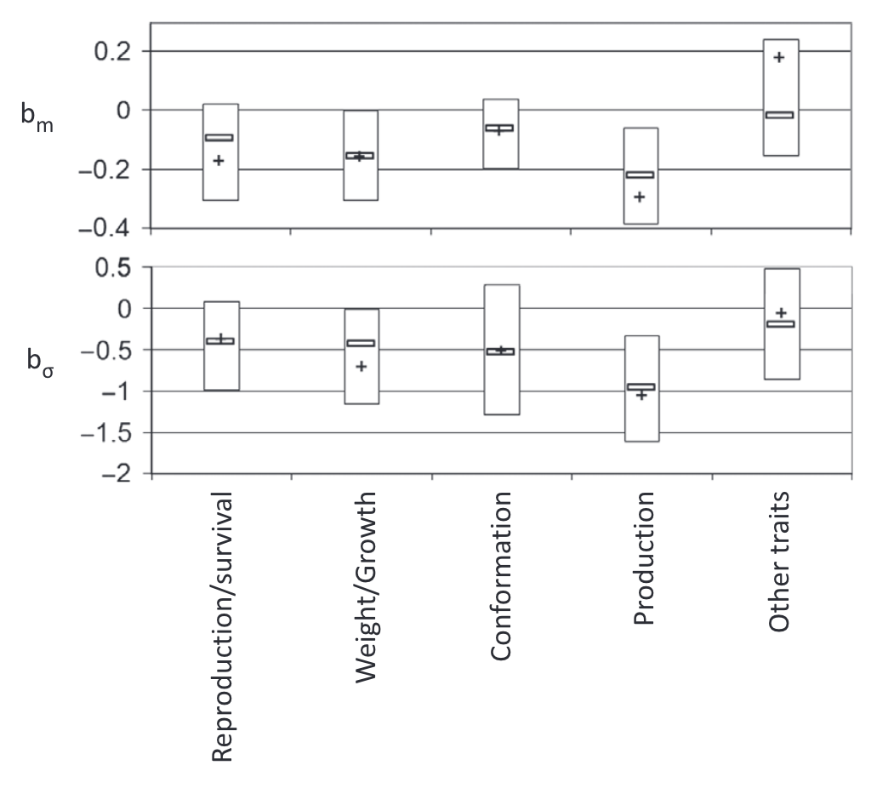
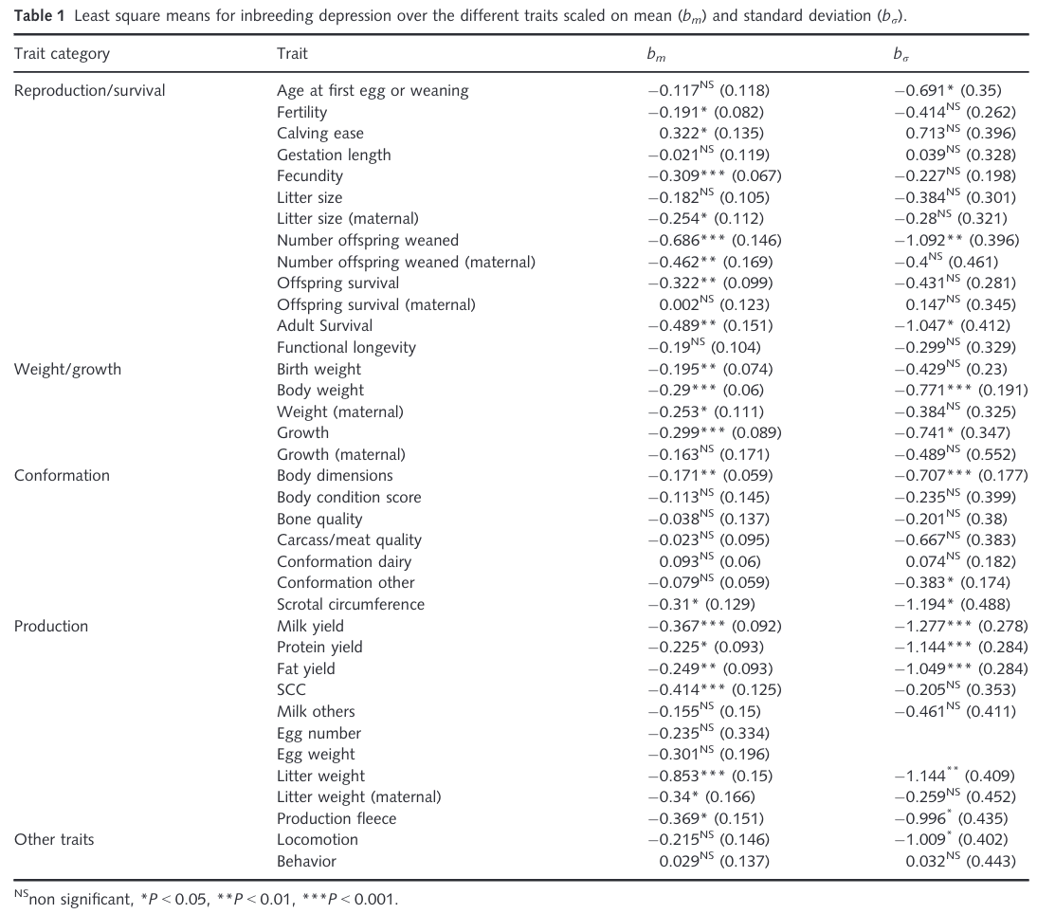
Inbreeding can be depressing
Source: Leroy (2014)

Slide 20
Should dairy farmers worry about inbreeding?
Change in phenotypic performance per 1% (0.25%) increase in inbreeding
Milk | Fat | Protein | PL | SCS | DPR | HCR | CCR | LIV
-73.6 | -2.70 | -2.10 | -0.28 | 0.01 | -0.22 | -0.22 | -0.31 | -0.11
-18.4 | -0.67 | -0.52 | -0.07 | 0.0025 | -0.05 | -0.05 | -0.08 | -0.03
Source: CDCB (https://webconnect.uscdcb.com/#/summary-stats/breed-means-bases-heterosis-inbreeding-regressions).
Change in genetic potential per year when selecting on NM$
Milk | Fat | Protein | PL | SCS | DPR | HCR | CCR | LIV
+126.9 | +7.7 | +4.4 | +0.49 | -0.02 | +0.03 | +0.15 | +0.15 | +0.25
Source: AGIL, ARS, USDA (https://www.ars.usda.gov/ARSUserFiles/80420530/Publications/ARR/nmcalc-2021_ARR-NM8.pdf).

Slide 21
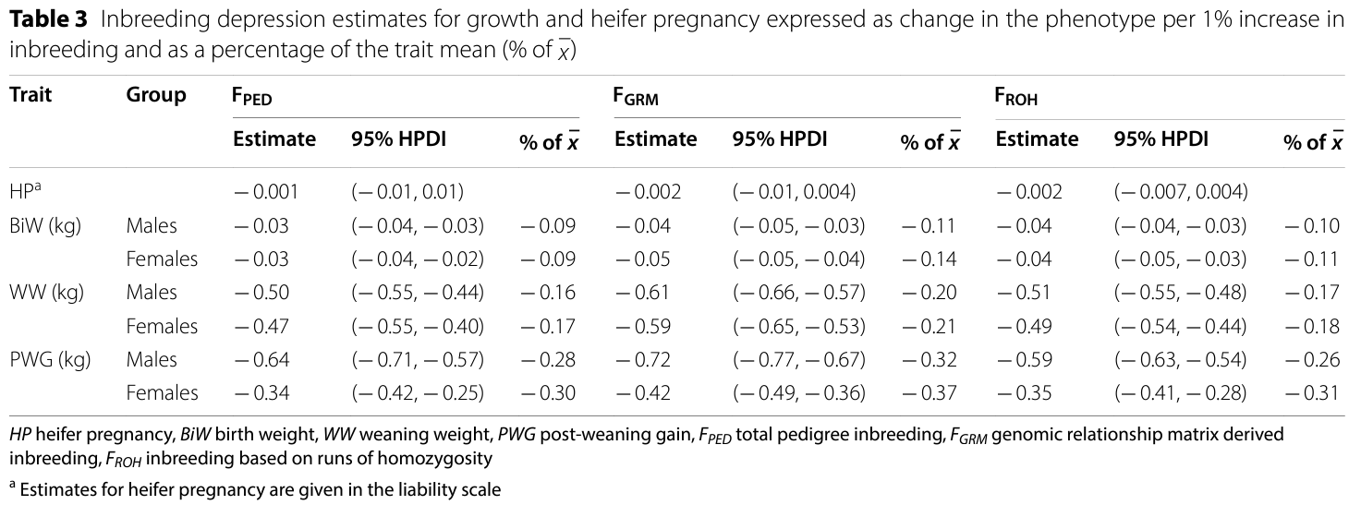
Should cattle ranchers worry about inbreeding?
Source: Lozada-Soto et al. (2021)

Slide 22
Nobody can agree on what to do about it
Point 5

Slide 23
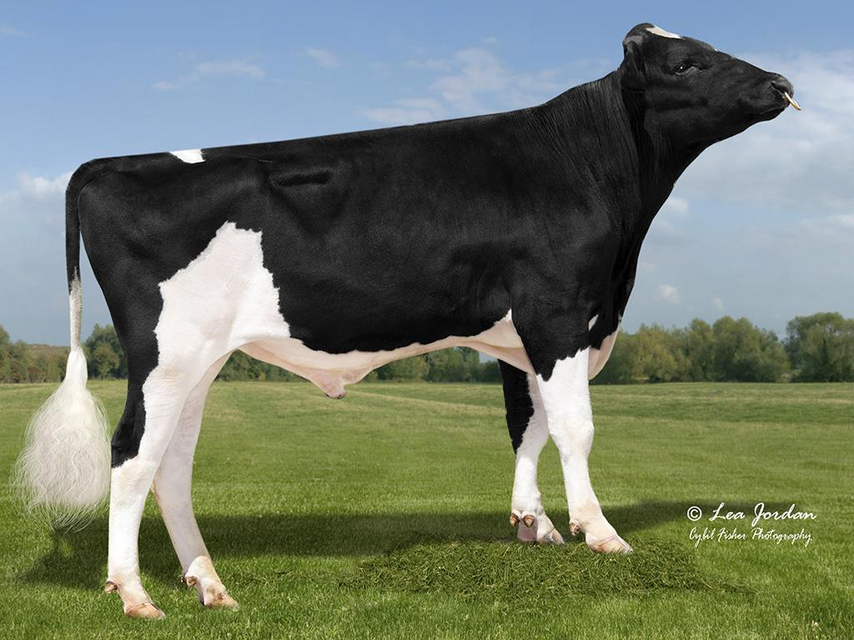
Can we adjust PTAs to account for inbreeding?
Penalize bulls whose daughters
are more related to the breed?
Use genomic rather than pedigree
inbreeding?
The US does both!
Limit active bulls from the same sire family?
What about embryo donors?
Source: Alta Genetics

Slide 24
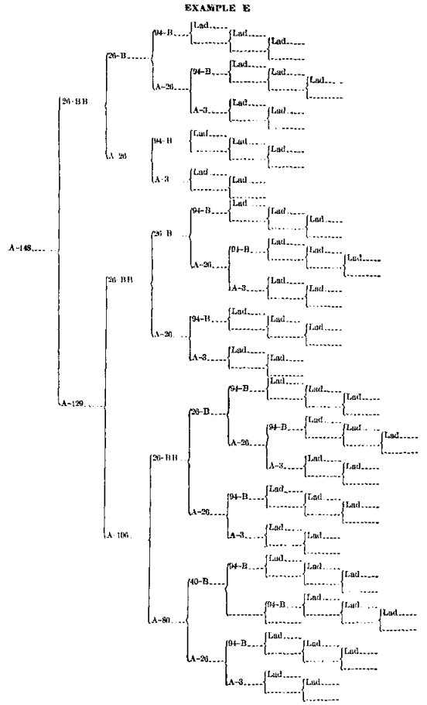
Should we trim pedigrees?
Inbreeding melts away with the
touch of a button!
Reflects the biological impact of new
versus old inbreeding
Some countries already do this
  Italy (4), Slovak Republic (3), UK (5)
  Some countries have more recent
  “founder” years

Slide 25
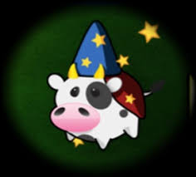
What if we don’t publish PTAs?
To avoid overuse of bulls, no PTA
will be published
Bulls will be mated at random to cows
Or, bulls can receive “red”, “yellow”, or “green” badges for each trait to indicate quality
Or, only the mate selection software knows the PTA

Slide 26
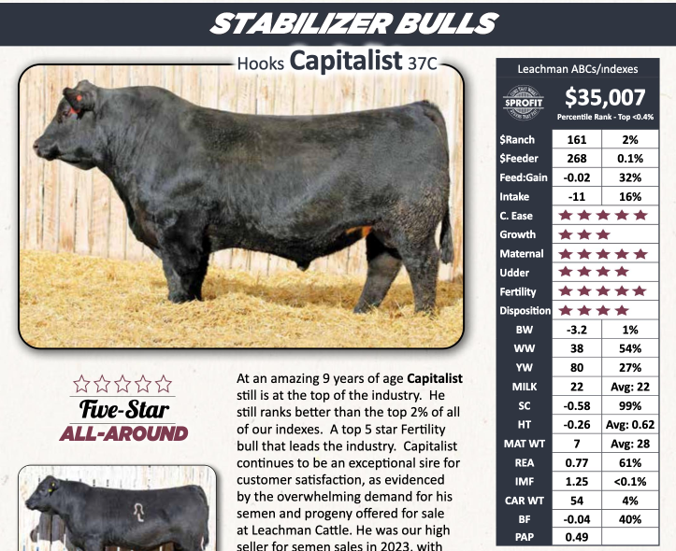
What if we don’t publish PTAs? (cont’d)
Beef cattle breeders appear to be ahead of the dairy sector on alternative ways of ranking bulls

Slide 27
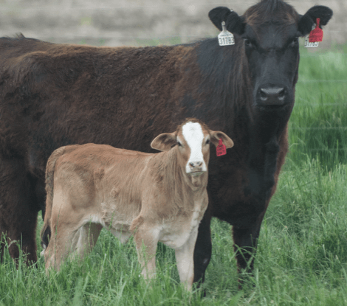
Could we use terminal dairy embryos?
Instead of selling semen to farmers, we
could sell only embryos that represent
the ideal terminal dairy cross
There would be no inbreeding!
Who will maintain the purebred lines needed for this program?
Is the cost of creating and transferring these embryos manageable?

Slide 28
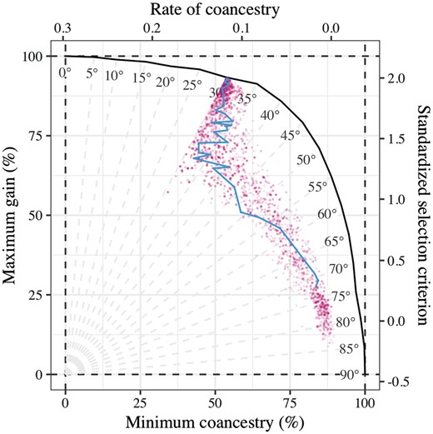
What if we change the index?
Add some measure of genetic
diversity to selection indices
A possible opportunity to use
subpopulation membership
Isn’t this just a less-efficient way of implementing optimal contribution theory,
which we’ve all been carefully ignoring?

Slide 29
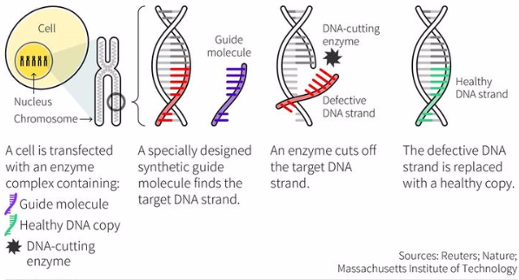
Maybe gene editing is the solution?
What if we just use gene editing to “fix” defects when we find them (Johnsson et al., 2019)?
  You only lose a few months with surrogate sires!
We can get rapid genetic
gain without consequences!
Do we know where it’s
important to have diversity?

Slide 30
Am I serious about this?
Genetic evaluation is a tool for ranking animals for selection, not managing genetic diversity
  We can favor “outcross” animals, if we can find them, and penalize “inbred” animals
  Such adjustments lack theoretical justification and can’t achieve what we want them to
Would we rather pretend we’re doing things, or make changes that have real impacts (Cole, 2024)?

Slide 31
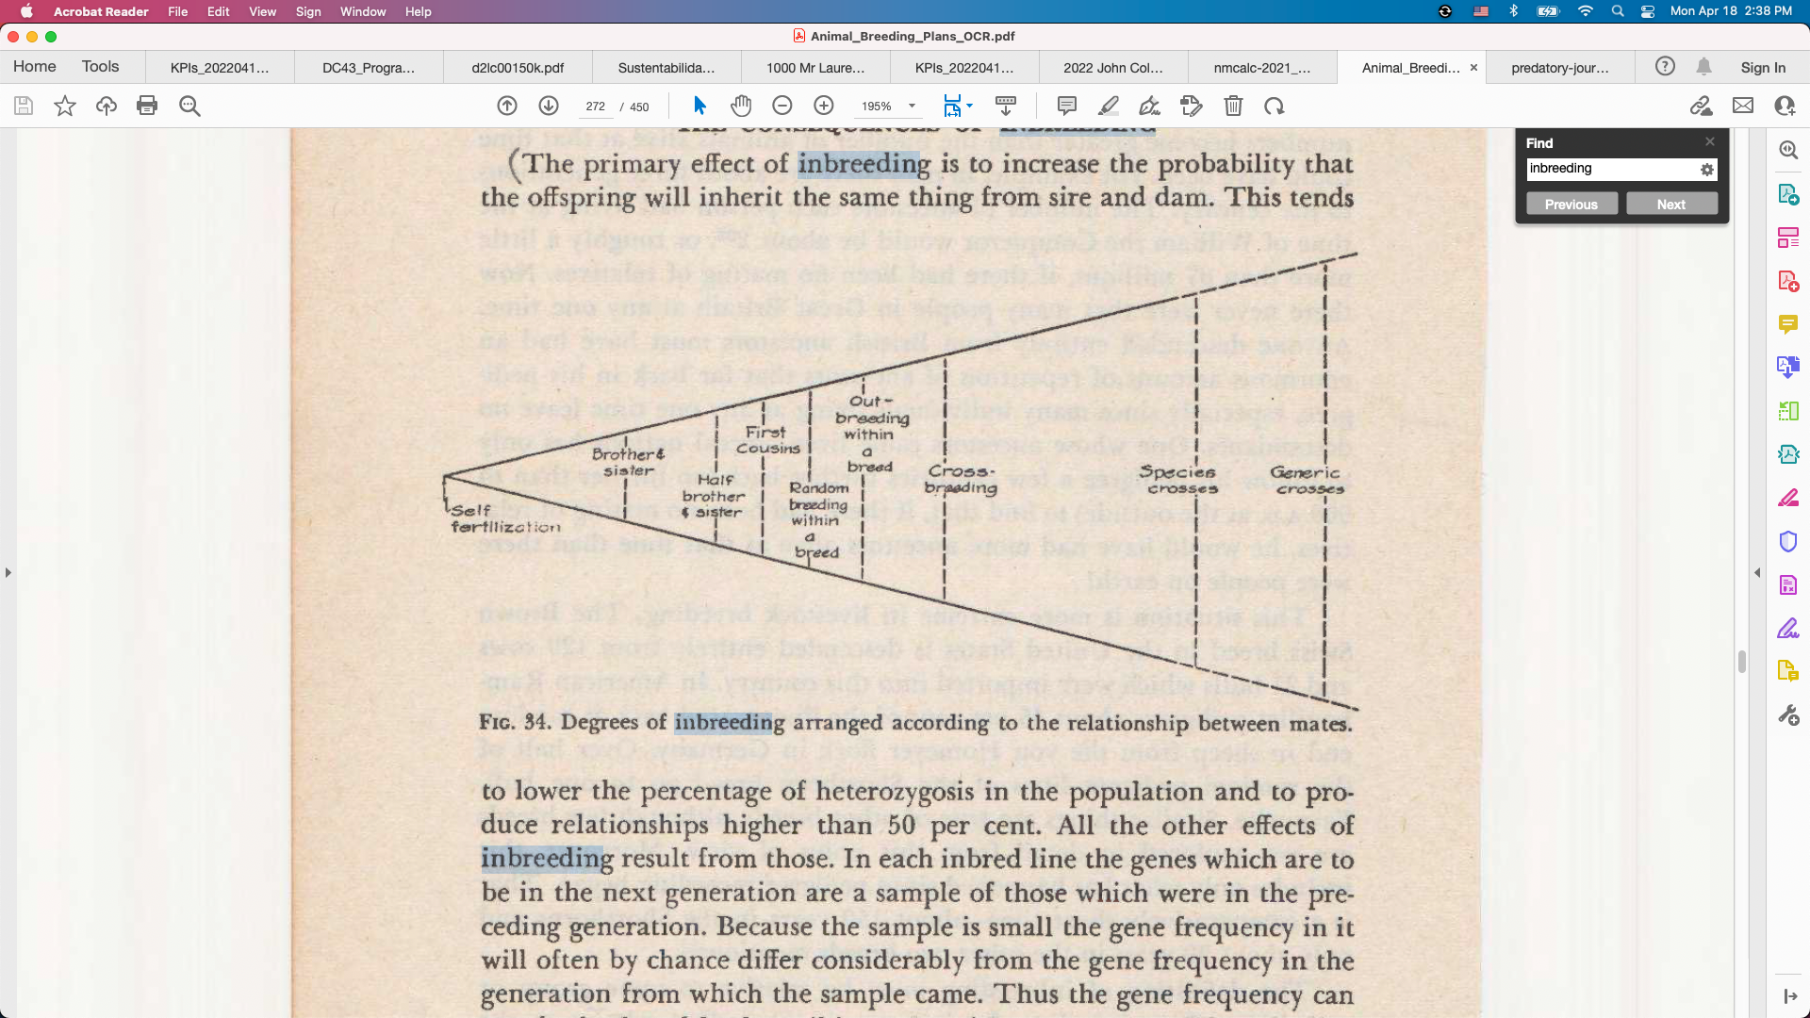
We can outcross between studs
AIs are creating sub-populations
within breeds because of genetic
protection programs
  Will this lead to rotational breeding from each stud in turn?
How much difference should we expect if we’re all using similar breeding objectives?
Source: Lush (1945)

Slide 32
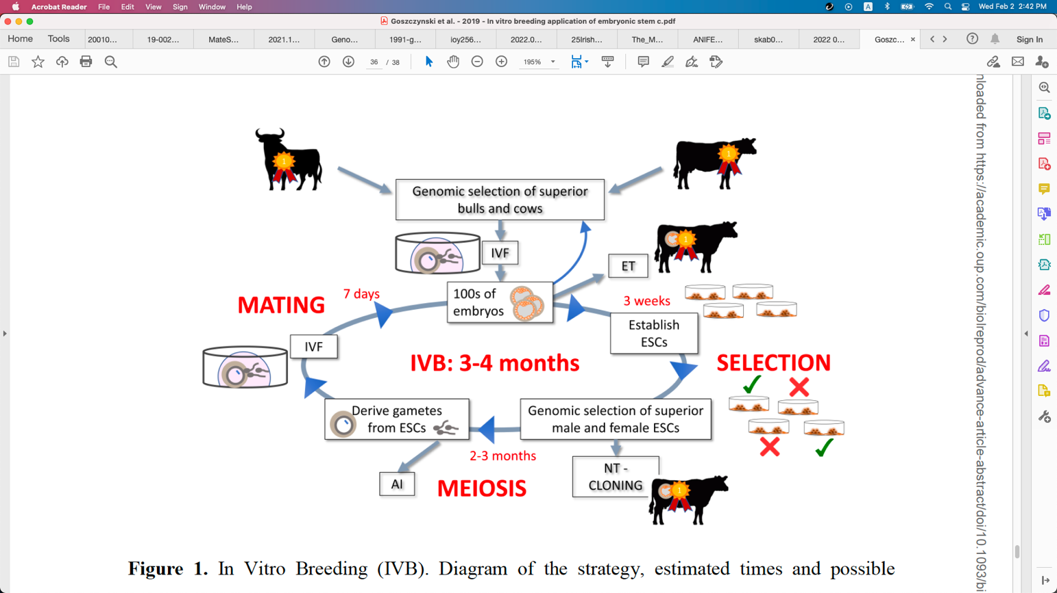
Will in vitro breeding ever work?
Embryonic stem cells can be turned into sperm and eggs and used to create a new generation of embryos (Goszczynski et al., 2018)
Faster genetic gain because less
time is needed to create the next
generation
Live animals eventually needed

Slide 33
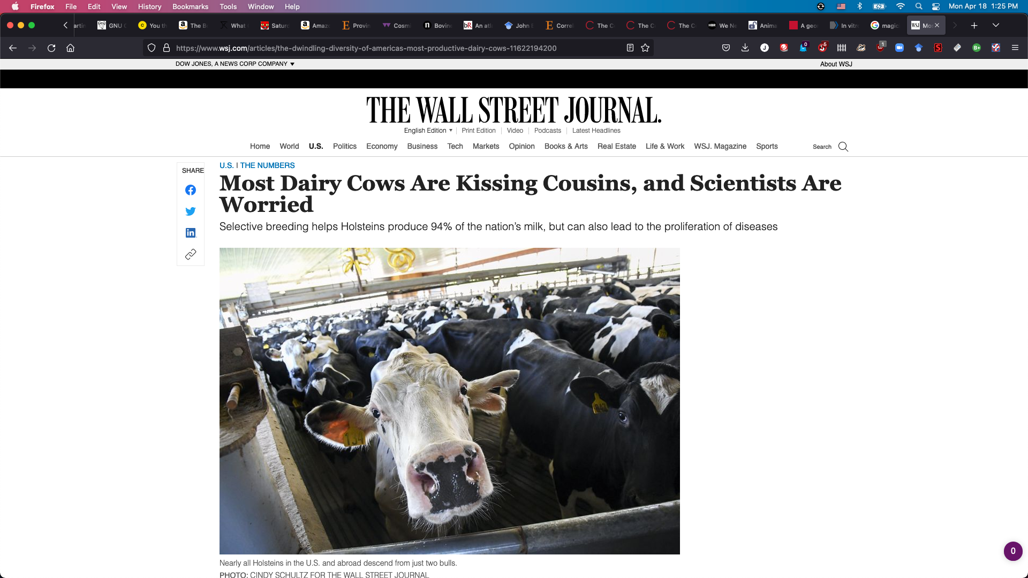
Will we retain license to operate?
Inbreeding may impact our
social license more than
production economics
People don’t understand
the selection on performance
practiced by livestock farmers
What will consumers, retailers, and bankers demand?

Slide 34
Are there better solutions to this problem?
Some ways to avoid inbreeding
Optimal contribution theory
Minimization of progeny inbreeding
Linear programming
Look-ahead mate selection
Selection against lethal alleles
Index selection including Mendelian sampling variance
Genomic selection including dominance
There are many theoretically
satisfying ideas that nobody
uses
Geneticists and AI staff don’t
breed cows, farmers do
Many cows are now mated
at random to a portfolio of bulls
Everyone’s neighbor should use different bulls

Slide 35
Conclusions

Slide 36
Are we concerned about the wrong thing?
“Selection, however - in marked contrast to its effectiveness in changing average merit - is a very feeble tool for changing homozygosity, except under the very simplest genetic situations…” (Lush, 1945)
“When the pure breeds finally reach equilibrium between the production of heterozygosis by mutations and the loss of heterozygosis because the effective number of animals in the breed is small, it is possible that the pure breed may support only a few scores of unfixed loci.” (Lush, 1945)

Slide 37
Closing thoughts
Homozygosity is bad when there’s inbreeding depression
Increased genetic load compromises animals’ adaptability
When there is tight control throughout the production chain (as in pork and poultry breeding) genetic diversity can be managed effectively

Slide 38
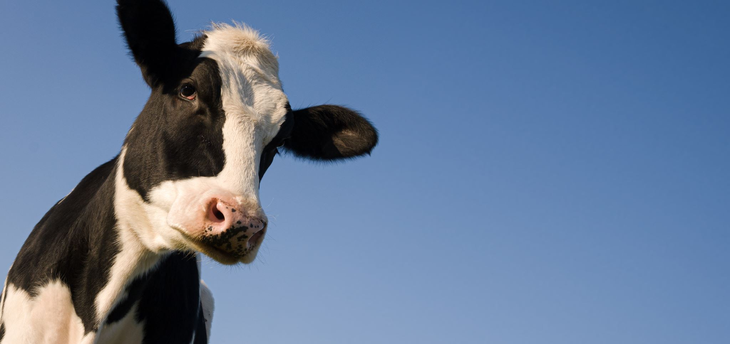
THANK YOU FOR YOUR ATTENTION!
QUESTIONS?

Slide 39
References
Cleveland, M.A., H.D. Blackburn, R.M. Enns, and D.J. Garrick. 2005. Changes in inbreeding of U.S. Herefords during the twentieth century. Journal of Animal Science 83:992–1001. https://doi.org/10.2527/2005.835992x.
Cole, J.B. 2024. Perspective: Can we actually do anything about inbreeding? J. Dairy Sci. 107:643–648. https://doi.org/10.3168/jds.2023-23958.
Cole, J.B., D.E. Franke, and E.A. Leighton. 2004. Population structure of a colony of dog guides. J. Anim. Sci. 82:2906–2912. https://doi.org/10.2527/2004.82102906x.
Cole, J.B., and P.M. VanRaden. 2011. Use of haplotypes to estimate Mendelian sampling effects and selection limits. J. Anim. Breed. Genet. https://doi.org/10.1111/j.1439-0388.2011.00922.x.
D’Ambrosio, J., F. Phocas, P. Haffray, A. Bestin, S. Brard-Fudulea, C. Poncet, E. Quillet, N. Dechamp, C. Fraslin, M. Charles, and M. Dupont-Nivet. 2019. Genome-wide estimates of genetic diversity, inbreeding and effective size of experimental and commercial rainbow trout lines undergoing selective breeding. Genet Sel Evol 51:26. https://doi.org/10.1186/s12711-019-0468-4.

Slide 40
References (cont’d)
Goszczynski, D.E., H. Cheng, S. Demyda-Peyrás, J.F. Medrano, J. Wu, and P.J. Ross. 2018. In vitro breeding: application of embryonic stem cells to animal production. Biol. Reprod. https://doi.org/10.1093/biolre/ioy256.
Holt, M., T. Meuwissen, and O. Vangen. 2005. Long‐term responses, changes in genetic variances and inbreeding depression from 122 generations of selection on increased litter size in mice. J. Anim. Breed. Genet. 122:199–209. https://doi.org/10.1111/j.1439-0388.2005.00526.x.
Howard, J.T., J.E. Pryce, C. Baes, and C. Maltecca. 2017. Invited review: Inbreeding in the genomics era: Inbreeding, inbreeding depression, and management of genomic variability. Journal of Dairy Science 100:6009–6024. https://doi.org/10.3168/jds.2017-12787.
Johnsson, M., R.C. Gaynor, J. Jenko, G. Gorjanc, D.-J. de Koning, and J.M. Hickey. 2019. Removal of alleles by genome editing (RAGE) against deleterious load. Genet. Sel. Evol. 51:14. https://doi.org/10.1186/s12711-019-0456-8.
Macedo, F.L., O.F. Christensen, and A. Legarra. 2021. Selection and drift reduce genetic variation for milk yield in Manech Tête Rousse dairy sheep. JDS Comm. 2:31–34. https://doi.org/10.3168/jdsc.2020-0010.

Slide 41
References (cont’d)
Leroy, G. 2014. Inbreeding depression in livestock species: review and meta‐analysis. Animal Genetics 45:618–628. https://doi.org/10.1111/age.12178.
Lozada-Soto, Emmanuel A., Christian Maltecca, Jicai Jiang, John B. Cole, Paul VanRaden, and Francesco Tiezzi. 2022. Genomic characterization of autozygosity and recent inbreeding trends in all major breeds of US dairy cattle. J. Dairy Sci. 105:8956-8971. https://doi.org/10.3168/jds.2022-22116.
Lozada-Soto, E.A., C. Maltecca, D. Lu, S. Miller, J.B. Cole, and F. Tiezzi. 2021. Trends in genetic diversity and the effect of inbreeding in American Angus cattle under genomic selection. Genetics, Selection, Evolution. 53:50. https://doi.org/10.1186/s12711-021-00644-z.
Lush, J.L. 1945. Animal Breeding Plans. 2nd ed. Iowa State College Press, Ames, IA.
McParland, S., J.F. Kearney, M. Rath, and D.P. Berry. 2007. Inbreeding trends and pedigree analysis of Irish dairy and beef cattle populations. Journal of Animal Science 85:322–331. https://doi.org/10.2527/jas.2006-367.

Slide 42
References (cont’d)
Nicholas, F.W., and C. Smith. 1983. Increased rates of genetic change in dairy cattle by embryo transfer and splitting. Anim. Prod. 36:341–353. https://doi.org/10.1017/S0003356100010382.
Rafter, P., N. McHugh, T. Pabiou, and D.P. Berry. 2022. Inbreeding trends and genetic diversity in purebred sheep populations. animal 16:100604. https://doi.org/10.1016/j.animal.2022.100604.
Robertson, A. 1961. Inbreeding in artificial selection programmes. Genet.Res. 2:189–194. https://doi.org/10.1017/S0016672300000690.
Verrier, E., J.J. Colleau, and J.L. Foulley. 1993. Long-term effects of selection based on the animal model BLUP in a finite population. Theoret. Appl. Genetics 87:446–454. https://doi.org/10.1007/BF00215090.
Villanueva, B., A. Fernández, M. Saura, A. Caballero, J. Fernández, E. Morales-González, M.A. Toro, and R. Pong-Wong. 2021. The value of genomic relationship matrices to estimate levels of inbreeding. Genet. Sel. Evol. 53:42. https://doi.org/10.1186/s12711-021-00635-0.

